Slide 1
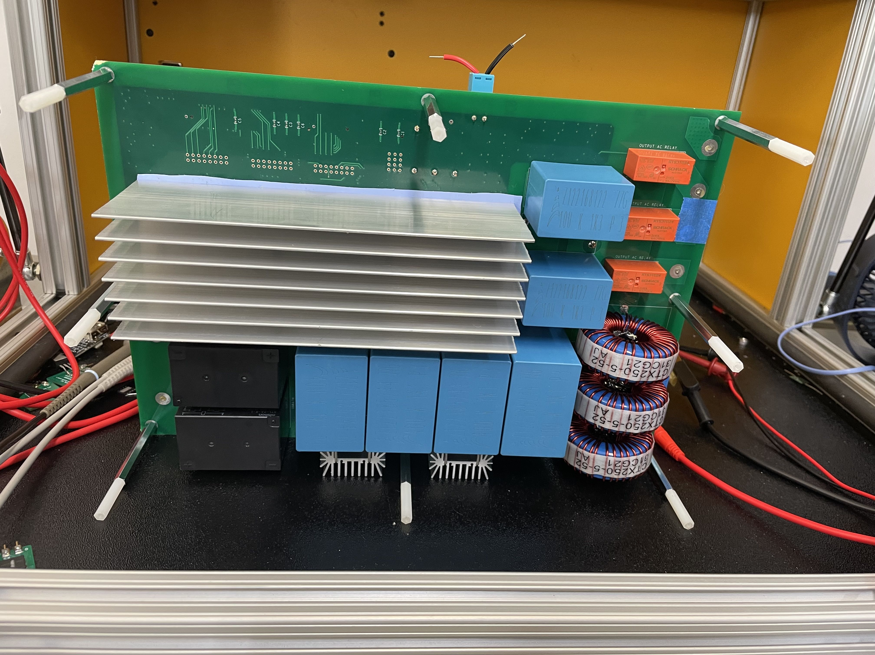
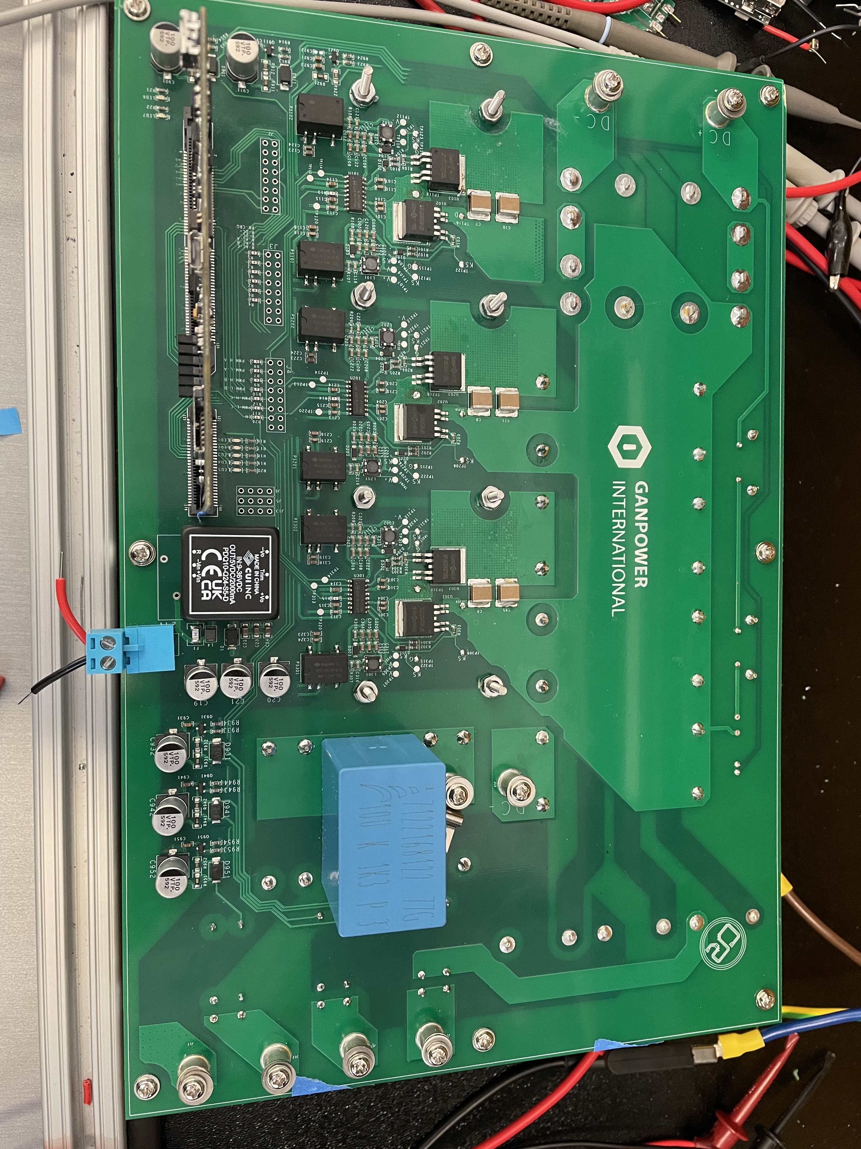
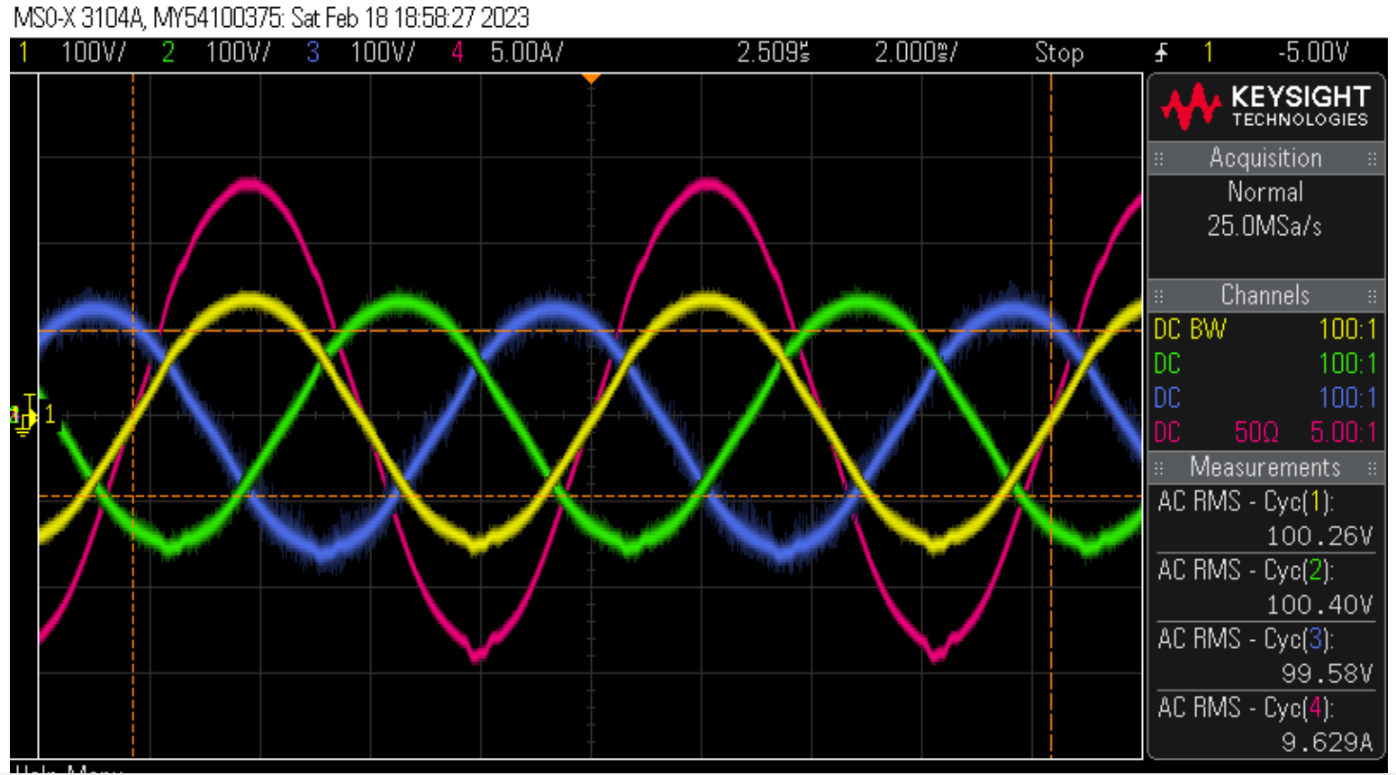
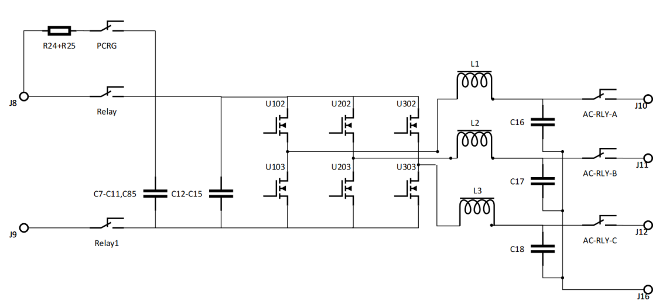
2023 Evaluation Board of 5kW 3-Phase GaN Inverter Power Stage
Features:
*Ultra wide input range: 10VDC-1200VDC, suitable for evaluating 650V and 1200V GaNFET/IC
*Convection cooled high efficiency 95-56%
* Industry Standard packages : TO263/TO247
Measured Output Waveforms
Frequency: 60Hz b. Phase separation: Phase A -> 0° Phase
B -> 120° Phase C -> 240° c.
Efficiency: 95~96%
d. Output wave amplitude: controlled by modulation index.
Output load: Resistive Y connected.
www.iganpower.com

Slide 2
Code | Package | BVdss | Id(A) | Ron(mΩ)
GPIHV05DK | TO252 | 1200 | 5 | 260
GPIHV7DK | TO252 | 1200 | 7 | 158
GPIHV10DK | TO252 | 1200 | 10 | 112
GPIHV15DK | TO252 | 1200 | 15 | 95
GPIHV30SB5L | TO263 | 1200 | 30 | 65
GPIHV30DFN | DFN8x8 | 1200 | 30 | 65
Code | Package | BVdss | Id(A) | Ron(mΩ)
GPI6508DFIC | DFN5x6 | 600 | 8 | 170
GPI6TIC15DFV | DFN8x8 | 900 | 15 | 85
GPI4TIC15DFV | DFN8x8 | 900 | 15 | 85
GPIRGIC15DFV | DFN8x8 | 900 | 15 | 85
GPI6TIC8DFV | DFN6x8 | 900 | 8 | 170
GPI4TIC8DFV | DFN6x8 | 900 | 8 | 170
www.iganpower.com

